Slide 1
Chapter 1
Introduction: Themes in the Study of Life

Slide 2
Overview: Inquiring About the World of Life
Evolution is the process of change that has transformed life on Earth
Biology is the scientific study of life
Biologists ask questions such as:
How a single cell develops into an organism
How the human mind works
How living things interact in communities
Copyright © 2008 Pearson Education, Inc., publishing as Pearson Benjamin Cummings

Slide 3
Life defies a simple, one-sentence definition
Life is recognized by what living things do
Video: Seahorse Camouflage
Copyright © 2008 Pearson Education, Inc., publishing as Pearson Benjamin Cummings
Notes:
Click to add notes

Slide 4
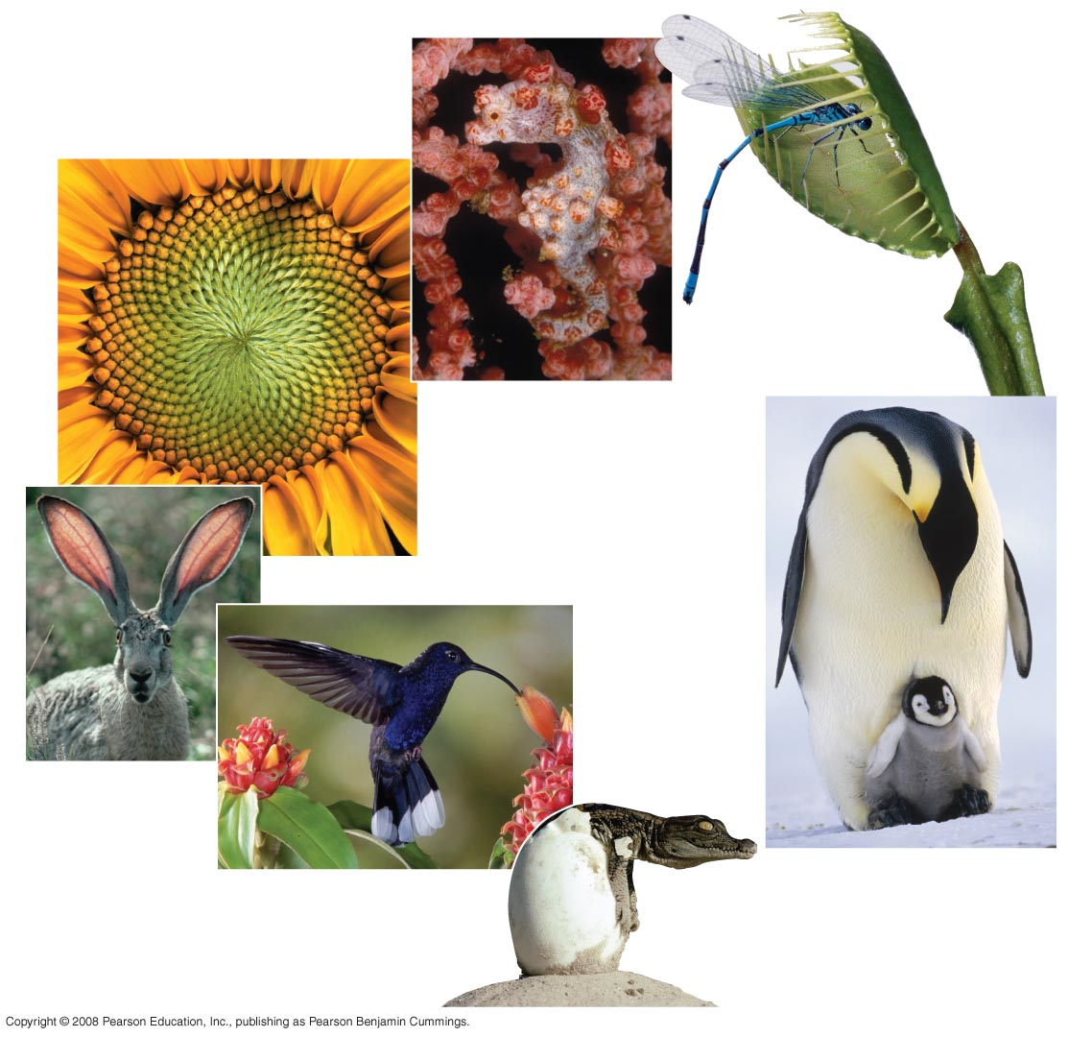
Fig. 1-3
Order
Response
to the
environment
Evolutionary adaptation
Regulation
Reproduction
Energy
processing
Growth and
development
Notes:
Figure 1.3 Some properties of life

Slide 5
Concept 1.1: Themes connect the concepts of biology
Biology consists of more than memorizing factual details
Themes help to organize biological information
Copyright © 2008 Pearson Education, Inc., publishing as Pearson Benjamin Cummings

Slide 6
Evolution, the Overarching Theme of Biology
Evolution makes sense of everything we know about living organisms
Organisms living on Earth are modified descendents of common ancestors
Copyright © 2008 Pearson Education, Inc., publishing as Pearson Benjamin Cummings

Slide 7
Theme: New properties emerge at each level in the biological hierarchy
Life can be studied at different levels from molecules to the entire living planet
The study of life can be divided into different levels of biological organization
Copyright © 2008 Pearson Education, Inc., publishing as Pearson Benjamin Cummings

Slide 8
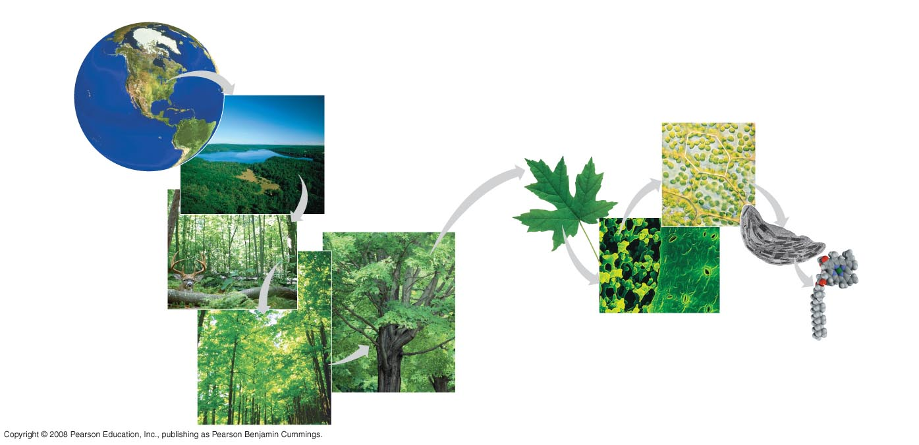
Fig. 1-4
The biosphere
Cells
Organs and organ systems
10 µm
Cell
Ecosystems
Organelles
Communities
1 µm
Atoms
Tissues
50 µm
Populations
Molecules
Organisms
Notes:
Figure 1.4 Levels of biological organization

Slide 9
Emergent Properties
Emergent properties result from the arrangement and interaction of parts within a system
Emergent properties characterize nonbiological entities as well
For example, a functioning bicycle emerges only when all of the necessary parts connect in the correct way
Copyright © 2008 Pearson Education, Inc., publishing as Pearson Benjamin Cummings

Slide 10
The Power and Limitations of Reductionism
Reductionism is the reduction of complex systems to simpler components that are more manageable to study
For example, the molecular structure of DNA
An understanding of biology balances reductionism with the study of emergent properties
For example, new understanding comes from studying the interactions of DNA with other molecules
Copyright © 2008 Pearson Education, Inc., publishing as Pearson Benjamin Cummings

Slide 11
Systems Biology
A system is a combination of components that function together
Systems biology constructs models for the dynamic behavior of whole biological systems
The systems approach poses questions such as:
How does a drug for blood pressure affect other organs?
How does increasing CO₂ alter the biosphere?
Copyright © 2008 Pearson Education, Inc., publishing as Pearson Benjamin Cummings

Slide 12
Theme: Organisms interact with their environments, exchanging matter and energy
Every organism interacts with its environment, including nonliving factors and other organisms
Both organisms and their environments are affected by the interactions between them
For example, a tree takes up water and minerals from the soil and carbon dioxide from the air; the tree releases oxygen to the air and roots help form soil
Copyright © 2008 Pearson Education, Inc., publishing as Pearson Benjamin Cummings

Slide 13
Ecosystem Dynamics
The dynamics of an ecosystem include two major processes:
Cycling of nutrients, in which materials acquired by plants eventually return to the soil
The flow of energy from sunlight to producers to consumers
Copyright © 2008 Pearson Education, Inc., publishing as Pearson Benjamin Cummings

Slide 14
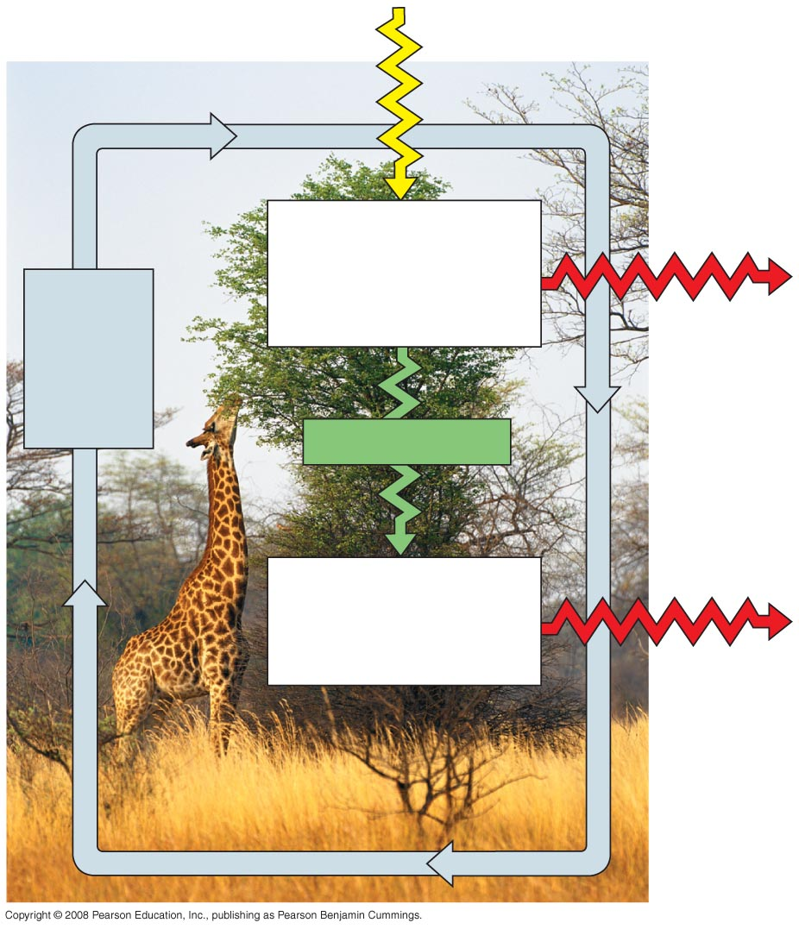
Fig. 1-5
Sunlight
Ecosystem
Producers
(plants and other photosynthetic
organisms)
Cycling
of
chemical
nutrients
Heat
Chemical energy
Consumers
(such as animals)
Heat
Notes:
Figure 1.5 Nutrient cycling and energy flow in an ecosystem

Slide 15
Energy Conversion
Work requires a source of energy
Energy can be stored in different forms, for example, light, chemical, kinetic, or thermal
The energy exchange between an organism and its environment often involves energy transformations
Energy flows through an ecosystem, usually entering as light and exiting as heat
Copyright © 2008 Pearson Education, Inc., publishing as Pearson Benjamin Cummings

Slide 16
Theme: Structure and function are correlated at all levels of biological organization
Structure and function of living organisms are closely related
For example, a leaf is thin and flat, maximizing the capture of light by chloroplasts
Copyright © 2008 Pearson Education, Inc., publishing as Pearson Benjamin Cummings

Slide 17
Fig. 1-6
(a) Wings
(b) Bones
Infoldings of
membrane
Mitochondrion
100 µm
0.5 µm
(c) Neurons
(d) Mitochondria
Notes:
Figure 1.6 Form fits function in a gull’s wing

Slide 18
Theme: Cells are an organism’s basic units of structure and function
The cell is the lowest level of organization that can perform all activities required for life
All cells:
Are enclosed by a membrane
Use DNA as their genetic information
The ability of cells to divide is the basis of all reproduction, growth, and repair of multicellular organisms
Copyright © 2008 Pearson Education, Inc., publishing as Pearson Benjamin Cummings

Slide 19
A eukaryotic cell has membrane-enclosed organelles, the largest of which is usually the nucleus
By comparison, a prokaryotic cell is simpler and usually smaller, and does not contain a nucleus or other membrane-enclosed organelles
Bacteria and Archaea are prokaryotic; plants, animals, fungi, and all other forms of life are eukaryotic
Copyright © 2008 Pearson Education, Inc., publishing as Pearson Benjamin Cummings

Slide 20
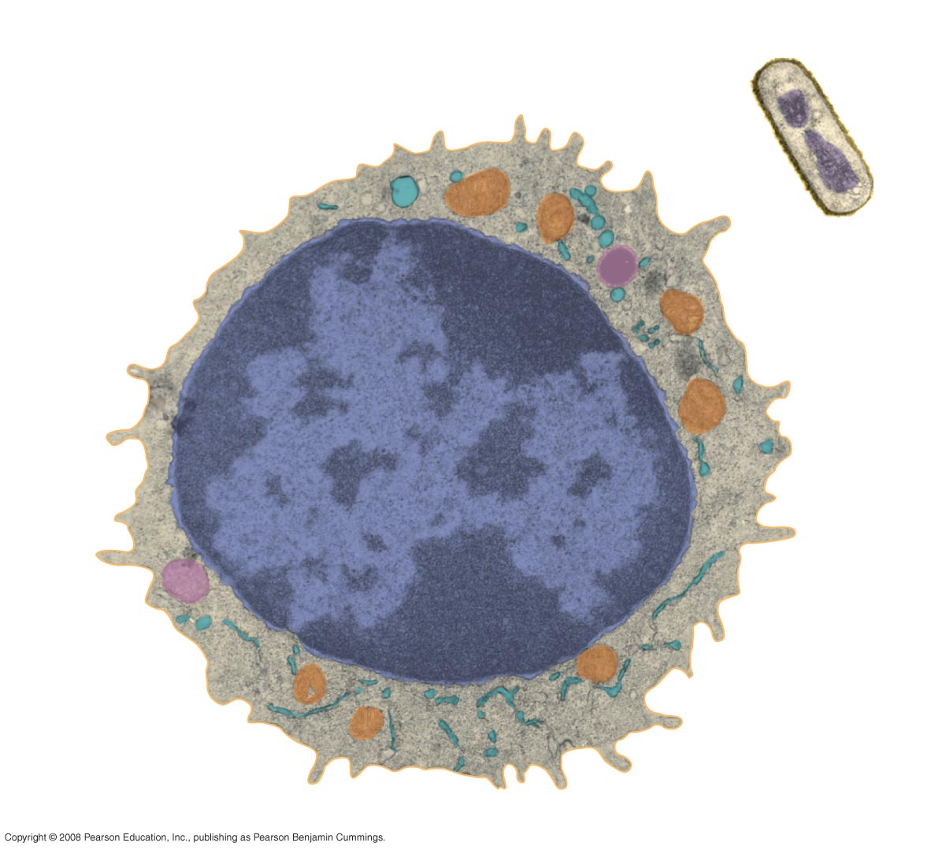
Fig. 1-8
Prokaryotic cell
Eukaryotic cell
DNA
(no nucleus)
Membrane
Membrane
Cytoplasm
Organelles
Nucleus (contains DNA)
1 µm
Notes:
Figure 1.8 Contrasting eukaryotic and prokaryotic cells in size and complexity

Slide 21
Theme: The continuity of life is based on heritable information in the form of DNA
Chromosomes contain most of a cell’s genetic material in the form of DNA (deoxyribonucleic acid)
DNA is the substance of genes
Genes are the units of inheritance that transmit information from parents to offspring
Copyright © 2008 Pearson Education, Inc., publishing as Pearson Benjamin Cummings

Slide 22
DNA Structure and Function
Each chromosome has one long DNA molecule with hundreds or thousands of genes
DNA is inherited by offspring from their parents
DNA controls the development and maintenance of organisms
Copyright © 2008 Pearson Education, Inc., publishing as Pearson Benjamin Cummings

Slide 23
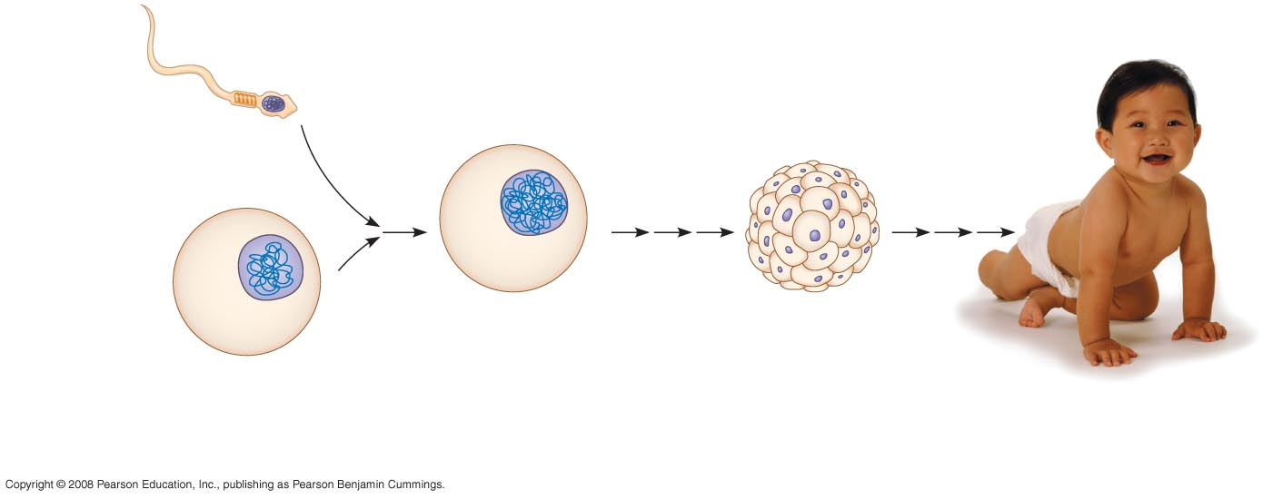
Fig. 1-9
Sperm cell
Nuclei
containing
DNA
Fertilized egg
with DNA from
both parents
Embryo’s cells with
copies of inherited DNA
Egg cell
Offspring with traits
inherited from
both parents
Notes:
Figure 1.9 Inherited DNA directs development of an organism

Slide 24
Each DNA molecule is made up of two long chains arranged in a double helix
Each link of a chain is one of four kinds of chemical building blocks called nucleotides
Copyright © 2008 Pearson Education, Inc., publishing as Pearson Benjamin Cummings

Slide 25
Genes control protein production indirectly
DNA is transcribed into RNA then translated into a protein
An organism’s genome is its entire set of genetic instructions
Copyright © 2008 Pearson Education, Inc., publishing as Pearson Benjamin Cummings

Slide 26
Systems Biology at the Levels of Cells and Molecules
The human genome and those of many other organisms have been sequenced using DNA-sequencing machines
Knowledge of a cell’s genes and proteins can be integrated using a systems approach
Copyright © 2008 Pearson Education, Inc., publishing as Pearson Benjamin Cummings

Slide 27
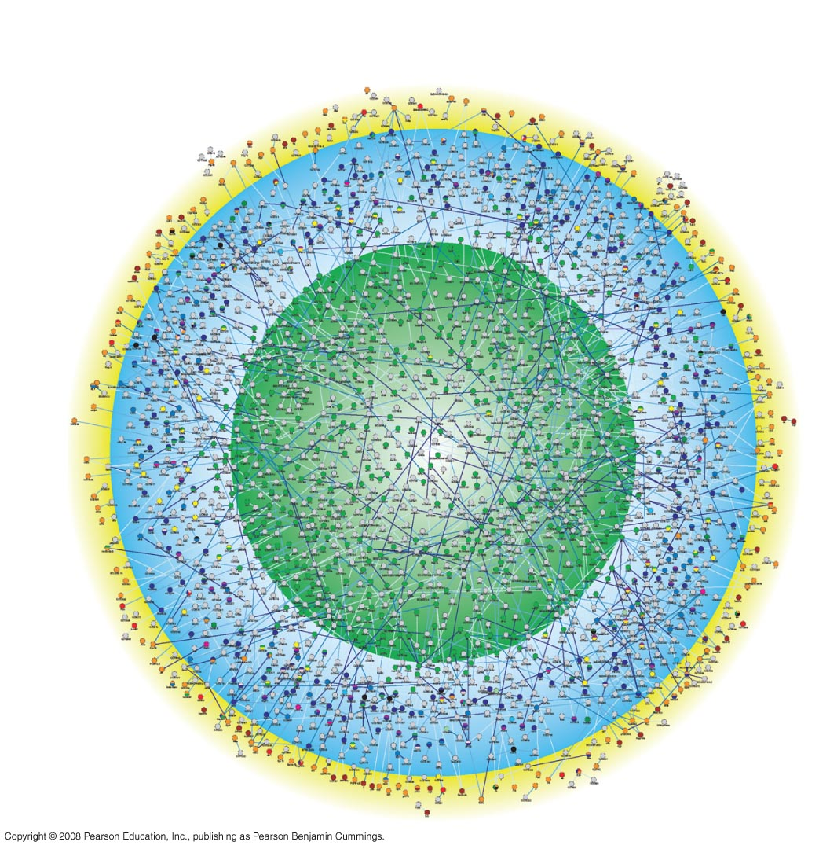
Fig. 1-12
Outer membrane
and cell surface
Cytoplasm
Nucleus
Notes:
Figure 1.12 A systems map of interactions among proteins in a cell

Slide 28
Advances in systems biology at the cellular and molecular level depend on
“High-throughput” technology, which yields enormous amounts of data
Bioinformatics, which is the use of computational tools to process a large volume of data
Interdisciplinary research teams
Copyright © 2008 Pearson Education, Inc., publishing as Pearson Benjamin Cummings

Slide 29
Theme: Feedback mechanisms regulate biological systems
Feedback mechanisms allow biological processes to self-regulate
Negative feedback means that as more of a product accumulates, the process that creates it slows and less of the product is produced
Positive feedback means that as more of a product accumulates, the process that creates it speeds up and more of the product is produced
Animation: Negative Feedback
Animation: Positive Feedback
Copyright © 2008 Pearson Education, Inc., publishing as Pearson Benjamin Cummings

Slide 30
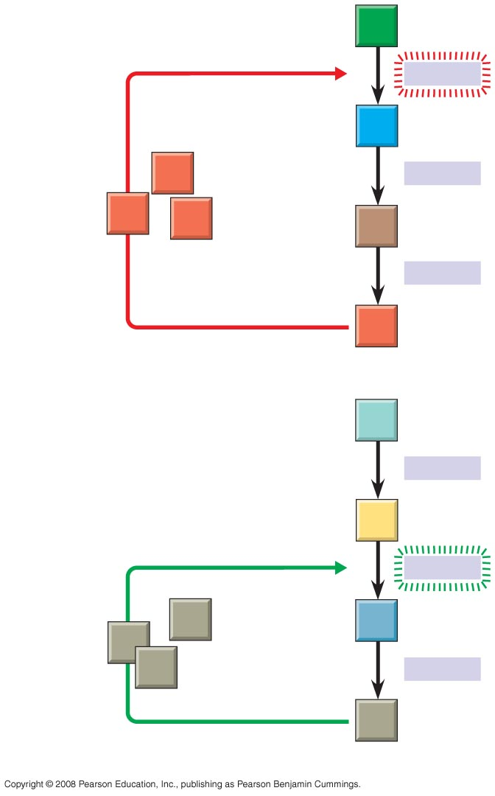
Fig. 1-13
Negative
feedback
A
−
Enzyme 1
B
Excess D
blocks a step
D
Enzyme 2
D
D
C
Enzyme 3
D
(a) Negative feedback
W
Enzyme 4
Positive
feedback
X
+
Enzyme 5
Excess Z
stimulates a
step
Z
Y
Z
Z
Enzyme 6
Z
(b) Positive feedback
Notes:
Figure 1.13 Regulation by feedback mechanisms

Slide 31
Concept 1.2: The Core Theme: Evolution accounts for the unity and diversity of life
“Nothing in biology makes sense except in the light of evolution”—Theodosius Dobzhansky
Evolution unifies biology at different scales of size throughout the history of life on Earth
Copyright © 2008 Pearson Education, Inc., publishing as Pearson Benjamin Cummings

Slide 32
Organizing the Diversity of Life
Approximately 1.8 million species have been identified and named to date, and thousands more are identified each year
Estimates of the total number of species that actually exist range from 10 million to over 100 million
Copyright © 2008 Pearson Education, Inc., publishing as Pearson Benjamin Cummings

Slide 33
Grouping Species: The Basic Idea
Taxonomy is the branch of biology that names and classifies species into groups of increasing breadth
Domains, followed by kingdoms, are the broadest units of classification
Copyright © 2008 Pearson Education, Inc., publishing as Pearson Benjamin Cummings

Slide 34
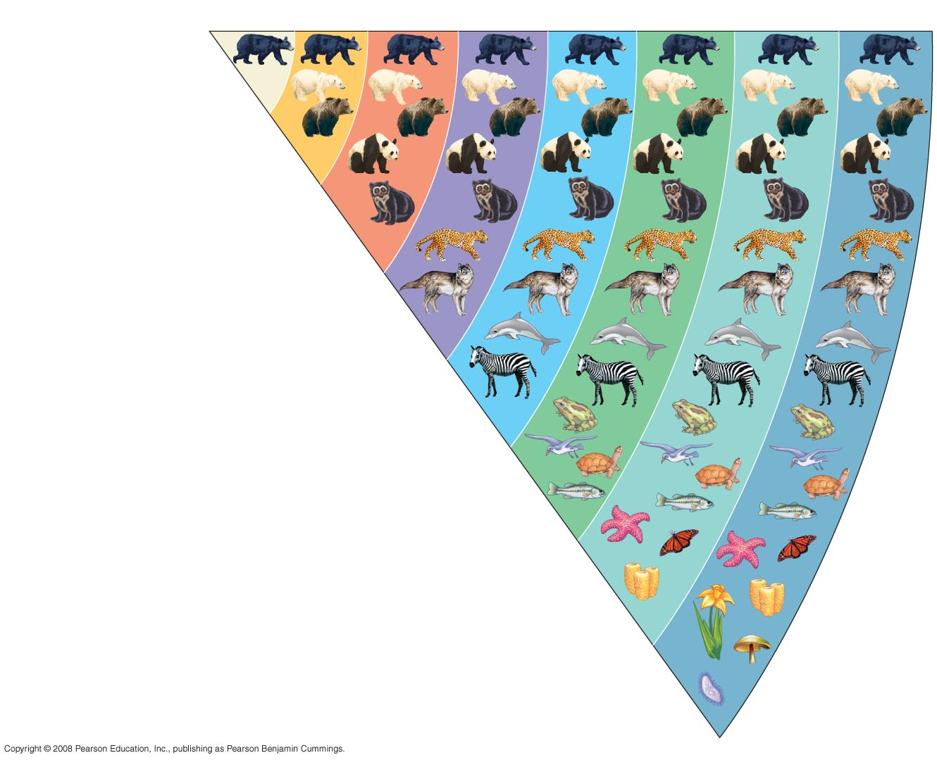
Fig. 1-14
Species
Genus
Family
Order
Class
Phylum
Kingdom
Domain
Ursus americanus
(American black bear)
Ursus
Ursidae
Carnivora
Mammalia
Chordata
Animalia
Eukarya
Notes:
Figure 1.14 Classifying life

Slide 35
The Three Domains of Life
The three-domain system is currently used, and replaces the old five-kingdom system
Domain Bacteria and domain Archaea comprise the prokaryotes
Domain Eukarya includes all eukaryotic organisms
Copyright © 2008 Pearson Education, Inc., publishing as Pearson Benjamin Cummings

Slide 36
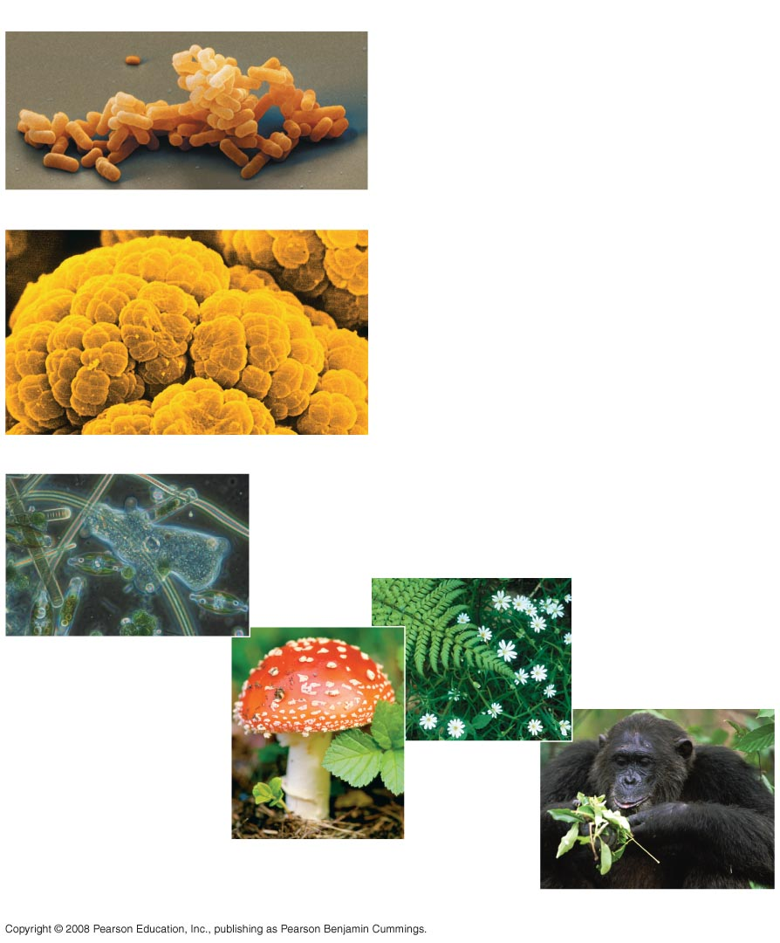
Fig. 1-15
(a) DOMAIN BACTERIA
(b) DOMAIN ARCHAEA
(c) DOMAIN EUKARYA
Protists
Kingdom
Plantae
Kingdom Fungi
Kingdom Animalia
Notes:
Figure 1.15 The three domains of life

Slide 37
The domain Eukarya includes three multicellular kingdoms:
Plantae
Fungi
Animalia
Other eukaryotic organisms were formerly grouped into a kingdom called Protista, though these are now often grouped into many separate kingdoms
Copyright © 2008 Pearson Education, Inc., publishing as Pearson Benjamin Cummings

Slide 38
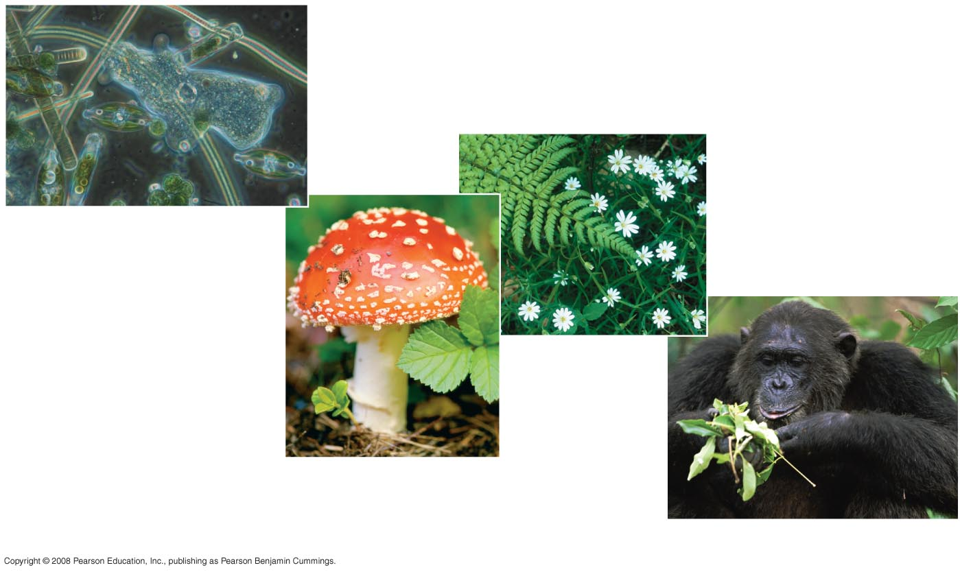
Fig. 1-15c
Protists
Kingdom Plantae
Kingdom Fungi
(c) DOMAIN EUKARYA
Kingdom Animalia
Notes:
Figure 1.15 The three domains of life

Slide 39
Unity in the Diversity of Life
A striking unity underlies the diversity of life; for example:
DNA is the universal genetic language common to all organisms
Unity is evident in many features of cell structure
Copyright © 2008 Pearson Education, Inc., publishing as Pearson Benjamin Cummings

Slide 40
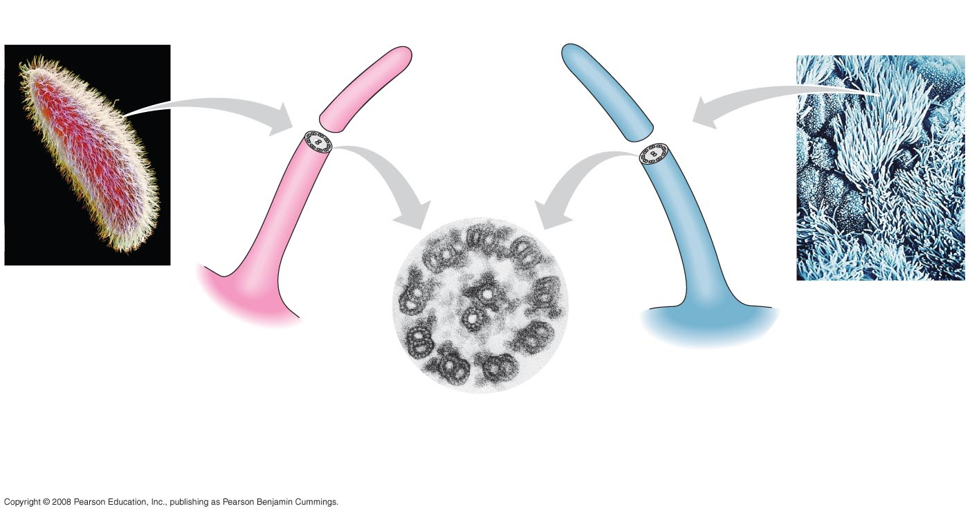
Fig. 1-16
15 µm
5 µm
Cilia of
Paramecium
Cilia of
windpipe
cells
0.1 µm
Cross section of a cilium, as viewed
with an electron microscope
Notes:
Figure 1.16 An example of unity underlying the diversity of life: the architecture of cilia in eukaryotes

Slide 41
Charles Darwin and the Theory of Natural Selection
Fossils and other evidence document the evolution of life on Earth over billions of years
Copyright © 2008 Pearson Education, Inc., publishing as Pearson Benjamin Cummings

Slide 42
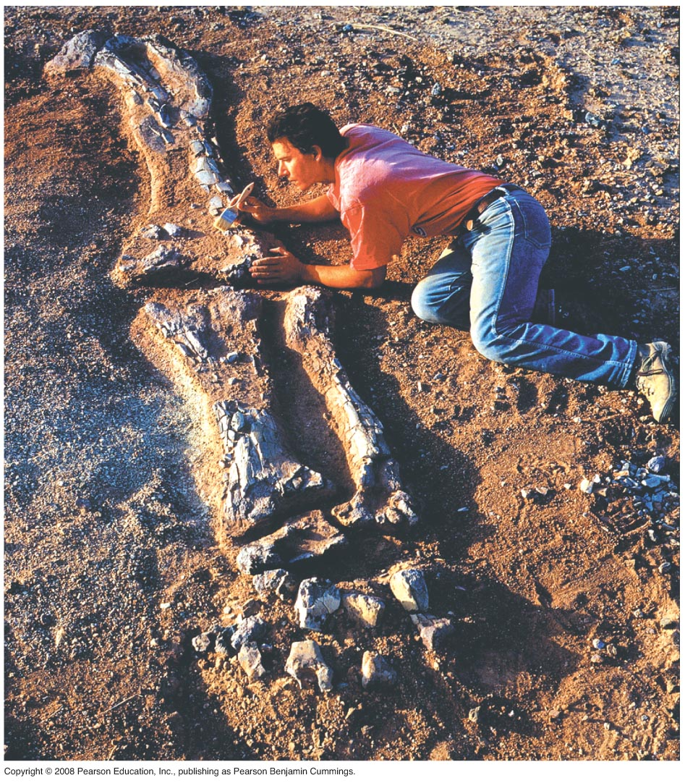
Fig. 1-17
Notes:
Figure 1.17 Digging into the past

Slide 43
Charles Darwin published On the Origin of Species by Means of Natural Selection in 1859
Darwin made two main points:
Species showed evidence of “descent with modification” from common ancestors
Natural selection is the mechanism behind “descent with modification”
Darwin’s theory explained the duality of unity and diversity
Copyright © 2008 Pearson Education, Inc., publishing as Pearson Benjamin Cummings

Slide 44
Darwin observed that:
Individuals in a population have traits that vary
Many of these traits are heritable (passed from parents to offspring)
More offspring are produced than survive
Competition is inevitable
Species generally suit their environment
Copyright © 2008 Pearson Education, Inc., publishing as Pearson Benjamin Cummings

Slide 45
Darwin inferred that:
Individuals that are best suited to their environment are more likely to survive and reproduce
Over time, more individuals in a population will have the advantageous traits
In other words, the natural environment “selects” for beneficial traits
Copyright © 2008 Pearson Education, Inc., publishing as Pearson Benjamin Cummings

Slide 46
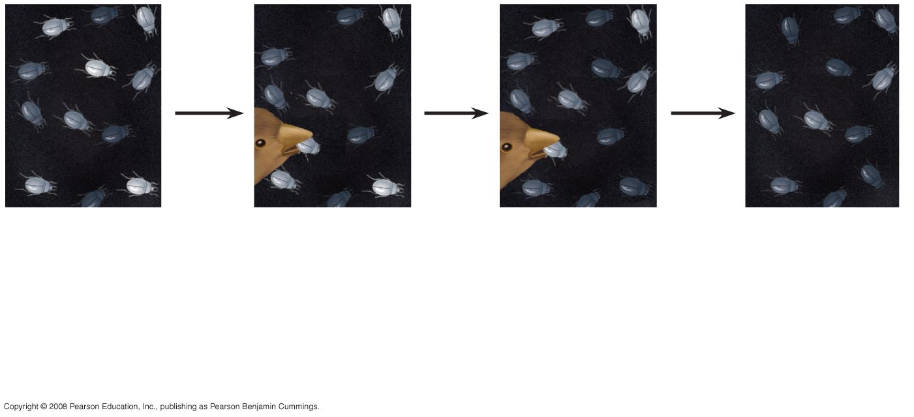
Fig. 1-20
1
Population
with varied
inherited traits.
2
Elimination
of individuals
with certain
traits.
3
Reproduction
of survivors.
4
Increasing
frequency
of traits that enhance survival and reproductive success.
Notes:
Figure 1.20 Natural selection

Slide 47
Natural selection is often evident in adaptations of organisms to their way of life and environment
Bat wings are an example of adaptation
Video: Soaring Hawk
Copyright © 2008 Pearson Education, Inc., publishing as Pearson Benjamin Cummings

Slide 48
The Tree of Life
“Unity in diversity” arises from “descent with modification”
For example, the forelimb of the bat, human, horse and the whale flipper all share a common skeletal architecture
Fossils provide additional evidence of anatomical unity from descent with modification
Copyright © 2008 Pearson Education, Inc., publishing as Pearson Benjamin Cummings

Slide 49
Darwin proposed that natural selection could cause an ancestral species to give rise to two or more descendent species
For example, the finch species of the Galápagos Islands
Evolutionary relationships are often illustrated with tree-like diagrams that show ancestors and their descendents
Copyright © 2008 Pearson Education, Inc., publishing as Pearson Benjamin Cummings

Slide 50
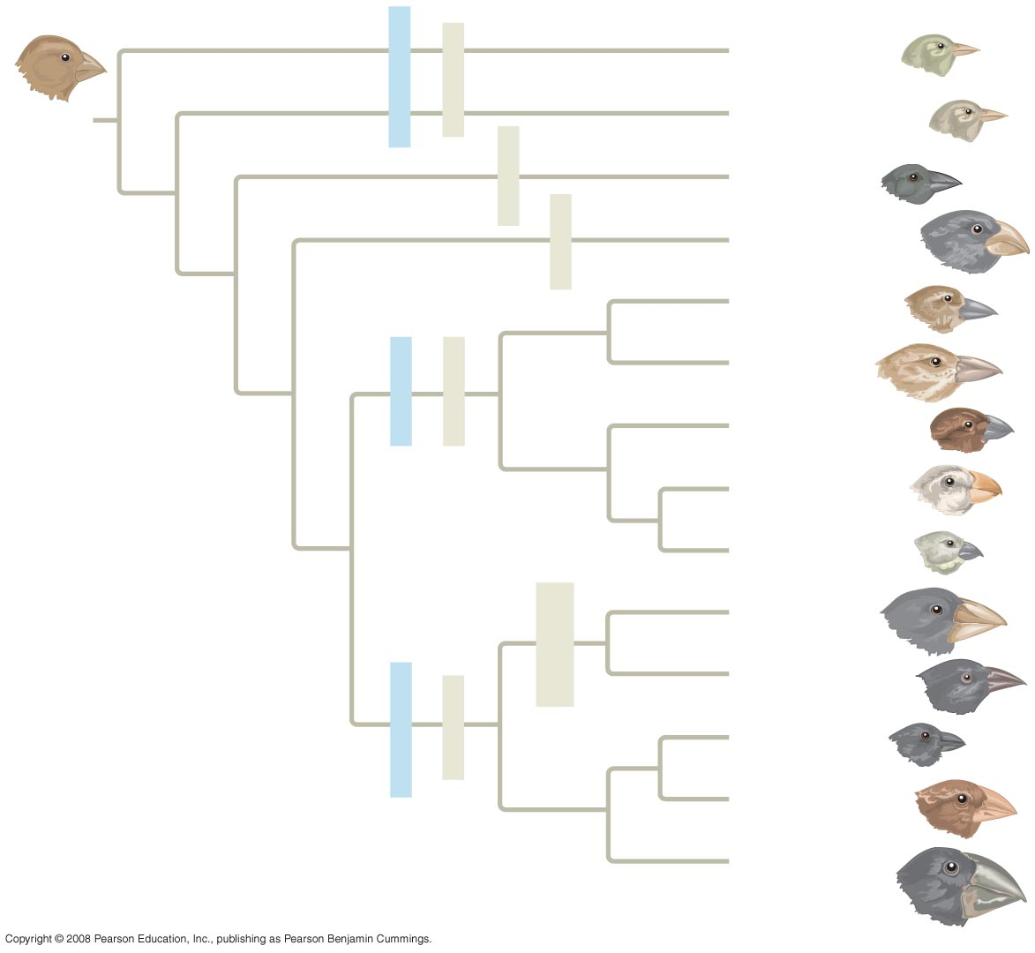
Fig. 1-22
Green warbler finch Certhidea olivacea
Warbler finches
Insect-eaters
COMMON
ANCESTOR
Gray warbler finch Certhidea fusca
Seed-eater
Sharp-beaked
ground finch Geospiza difficilis
Bud-eater
Vegetarian finch Platyspiza crassirostris
Mangrove finch Cactospiza heliobates
Woodpecker finch Cactospiza pallida
Tree finches
Insect-eaters
Medium tree finch Camarhynchus pauper
Large tree finch Camarhynchus psittacula
Small tree finch Camarhynchus parvulus
Large cactus
ground finch
Geospiza conirostris
Cactus-flower-eaters
Cactus ground finch
Geospiza scandens
Seed-eaters
Ground finches
Small ground finch
Geospiza fuliginosa
Medium ground finch
Geospiza fortis
Large ground finch
Geospiza magnirostris
Notes:
Figure 1.22 Descent with modification: adaptive radiation of finches on the Galápagos Islands

Slide 51
Concept 1.3: Scientists use two main forms of inquiry in their study of nature
The word Science is derived from Latin and means “to know”
Inquiry is the search for information and explanation
There are two main types of scientific inquiry: discovery science and hypothesis-based science
Copyright © 2008 Pearson Education, Inc., publishing as Pearson Benjamin Cummings

Slide 52
Discovery Science
Discovery science describes natural structures and processes
This approach is based on observation and the analysis of data
Copyright © 2008 Pearson Education, Inc., publishing as Pearson Benjamin Cummings

Slide 53
Types of Data
Data are recorded observations or items of information
Data fall into two categories
Qualitative, or descriptions rather than measurements
Quantitative, or recorded measurements, which are sometimes organized into tables and graphs
Copyright © 2008 Pearson Education, Inc., publishing as Pearson Benjamin Cummings

Slide 54
Induction in Discovery Science
Inductive reasoning draws conclusions through the logical process of induction
Repeat specific observations can lead to important generalizations
For example, “the sun always rises in the east”
Copyright © 2008 Pearson Education, Inc., publishing as Pearson Benjamin Cummings

Slide 55
Hypothesis-Based Science
Observations can lead us to ask questions and propose hypothetical explanations called hypotheses
Copyright © 2008 Pearson Education, Inc., publishing as Pearson Benjamin Cummings

Slide 56
The Role of Hypotheses in Inquiry
A hypothesis is a tentative answer to a well-framed question
A scientific hypothesis leads to predictions that can be tested by observation or experimentation
Copyright © 2008 Pearson Education, Inc., publishing as Pearson Benjamin Cummings

Slide 57
For example,
Observation: Your flashlight doesn’t work
Question: Why doesn’t your flashlight work?
Hypothesis 1: The batteries are dead
Hypothesis 2: The bulb is burnt out
Both these hypotheses are testable
Copyright © 2008 Pearson Education, Inc., publishing as Pearson Benjamin Cummings

Slide 58
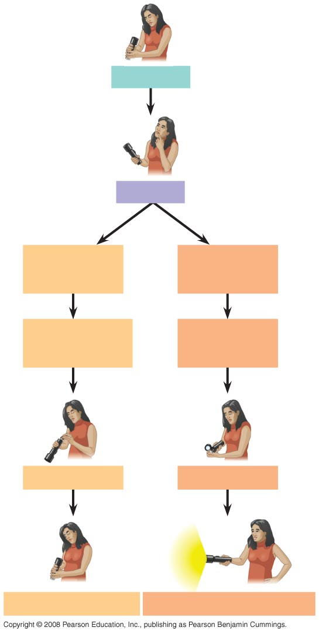
Fig. 1-24
Observations
Question
Hypothesis #1:
Dead batteries
Hypothesis #2:
Burnt-out bulb
Prediction:
Replacing batteries
will fix problem
Prediction:
Replacing bulb
will fix problem
Test prediction
Test prediction
Test falsifies hypothesis
Test does not falsify hypothesis
Notes:
Figure 1.24 A campground example of hypothesis-based inquiry

Slide 59
Deduction: The “If…Then” Logic of Hypothesis Based Science
Deductive reasoning uses general premises to make specific predictions
For example, if organisms are made of cells (premise 1), and humans are organisms (premise 2), then humans are composed of cells (deductive prediction)
Copyright © 2008 Pearson Education, Inc., publishing as Pearson Benjamin Cummings

Slide 60
A Closer Look at Hypotheses in Scientific Inquiry
A hypothesis must be testable and falsifiable
Hypothesis-based science often makes use of two or more alternative hypotheses
Failure to falsify a hypothesis does not prove that hypothesis
For example, you replace your flashlight bulb, and it now works; this supports the hypothesis that your bulb was burnt out, but does not prove it (perhaps the first bulb was inserted incorrectly)
Copyright © 2008 Pearson Education, Inc., publishing as Pearson Benjamin Cummings

Slide 61
The Myth of the Scientific Method
The scientific method is an idealized process of inquiry
Hypothesis-based science is based on the “textbook” scientific method but rarely follows all the ordered steps
Discovery science has made important contributions with very little dependence on the so-called scientific method
Copyright © 2008 Pearson Education, Inc., publishing as Pearson Benjamin Cummings

Slide 62
A Case Study in Scientific Inquiry: Investigating Mimicry in Snake Populations
Many poisonous species are brightly colored, which warns potential predators
Mimics are harmless species that closely resemble poisonous species
Henry Bates hypothesized that this mimicry evolved in harmless species as an evolutionary adaptation that reduces their chances of being eaten
Copyright © 2008 Pearson Education, Inc., publishing as Pearson Benjamin Cummings

Slide 63
This hypothesis was tested with the poisonous eastern coral snake and its mimic the nonpoisonous scarlet kingsnake
Both species live in the Carolinas, but the kingsnake is also found in regions without poisonous coral snakes
If predators inherit an avoidance of the coral snake’s coloration, then the colorful kingsnake will be attacked less often in the regions where coral snakes are present
Copyright © 2008 Pearson Education, Inc., publishing as Pearson Benjamin Cummings

Slide 64
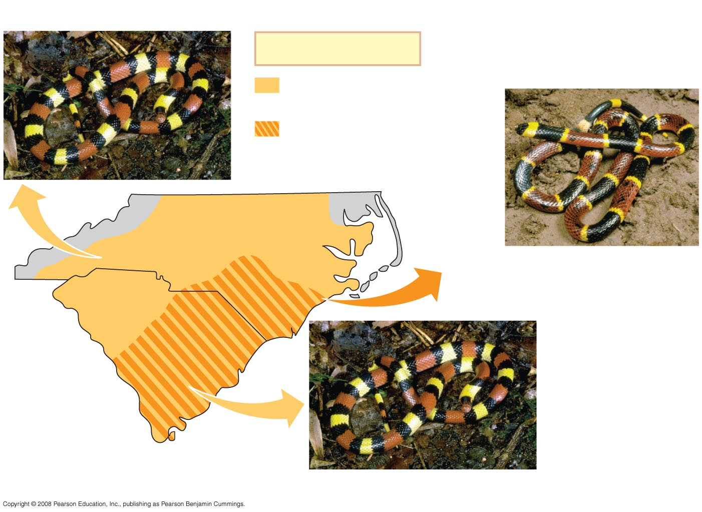
Fig. 1-25
Scarlet kingsnake (nonpoisonous)
Key
Range of scarlet
kingsnake only
Overlapping ranges of
scarlet kingsnake and
eastern coral snake
North Carolina
Eastern coral snake (poisonous)
South Carolina
Scarlet kingsnake (nonpoisonous)
Notes:
Figure 1.25 The geographic ranges of a poisonous snake and its mimic

Slide 65
Field Experiments with Artificial Snakes
To test this mimicry hypothesis, researchers made hundreds of artificial snakes:
An experimental group resembling kingsnakes
A control group resembling plain brown snakes
Equal numbers of both types were placed at field sites, including areas without poisonous coral snakes
Copyright © 2008 Pearson Education, Inc., publishing as Pearson Benjamin Cummings

Slide 66
After four weeks, the scientists retrieved the artificial snakes and counted bite or claw marks
The data fit the predictions of the mimicry hypothesis: the ringed snakes were attacked less frequently in the geographic region where coral snakes were found
Copyright © 2008 Pearson Education, Inc., publishing as Pearson Benjamin Cummings

Slide 67
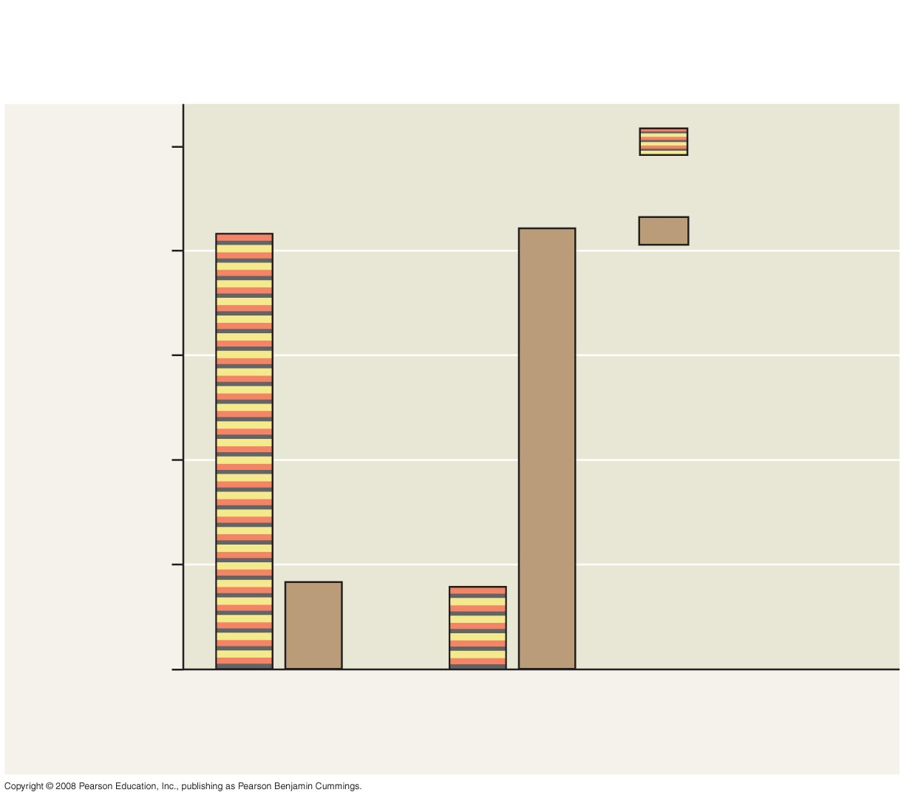
Fig. 1-27
RESULTS
100
Artificial kingsnakes
83%
84%
Brown
artificial snakes
80
60
Percent of total attacks
on artificial snakes
40
20
17%
16%
0
Coral snakes
absent
Coral snakes
present
Notes:
Figure 1.27 Does the presence of poisonous coral snakes affect predation rates on their mimics, kingsnakes?

Slide 68
Designing Controlled Experiments
A controlled experiment compares an experimental group (the artificial kingsnakes) with a control group (the artificial brown snakes)
Ideally, only the variable of interest (the color pattern of the artificial snakes) differs between the control and experimental groups
A controlled experiment means that control groups are used to cancel the effects of unwanted variables
A controlled experiment does not mean that all unwanted variables are kept constant
Copyright © 2008 Pearson Education, Inc., publishing as Pearson Benjamin Cummings

Slide 69
Limitations of Science
In science, observations and experimental results must be repeatable
Science cannot support or falsify supernatural explanations, which are outside the bounds of science
Copyright © 2008 Pearson Education, Inc., publishing as Pearson Benjamin Cummings

Slide 70
Theories in Science
In the context of science, a theory is:
Broader in scope than a hypothesis
General, and can lead to new testable hypotheses
Supported by a large body of evidence in comparison to a hypothesis
Copyright © 2008 Pearson Education, Inc., publishing as Pearson Benjamin Cummings

Slide 71
Model Building in Science
Models are representations of natural phenomena and can take the form of:
Diagrams
Three-dimensional objects
Computer programs
Mathematical equations
Copyright © 2008 Pearson Education, Inc., publishing as Pearson Benjamin Cummings

Slide 72
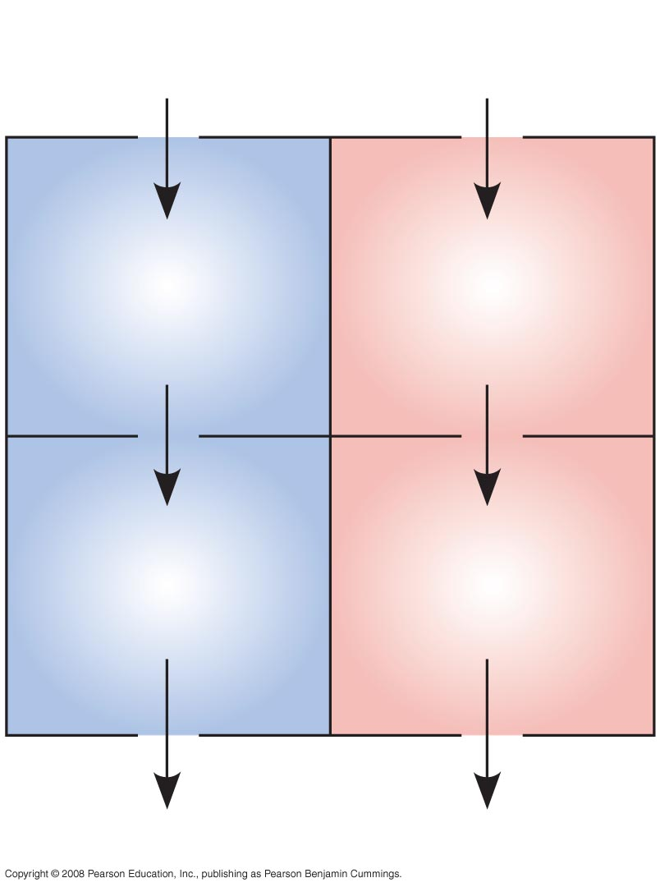
Fig. 1-28
From
body
From
lungs
Right
atrium
Left
atrium
Right
ventricle
Left
ventricle
To lungs
To body
Notes:
Figure 1.28 A model of the blood flow through the four chambers of a human heart

Slide 73
The Culture of Science
Most scientists work in teams, which often include graduate and undergraduate students
Good communication is important in order to share results through seminars, publications, and websites
Copyright © 2008 Pearson Education, Inc., publishing as Pearson Benjamin Cummings

Slide 74
Science, Technology, and Society
The goal of science is to understand natural phenomena
The goal of technology is to apply scientific knowledge for some specific purpose
Science and technology are interdependent
Biology is marked by “discoveries,” while technology is marked by “inventions”
Copyright © 2008 Pearson Education, Inc., publishing as Pearson Benjamin Cummings

Slide 75
The combination of science and technology has dramatic effects on society
For example, the discovery of DNA by James Watson and Francis Crick allowed for advances in DNA technology such as testing for hereditary diseases
Ethical issues can arise from new technology, but have as much to do with politics, economics, and cultural values as with science and technology
Copyright © 2008 Pearson Education, Inc., publishing as Pearson Benjamin Cummings

Slide 76
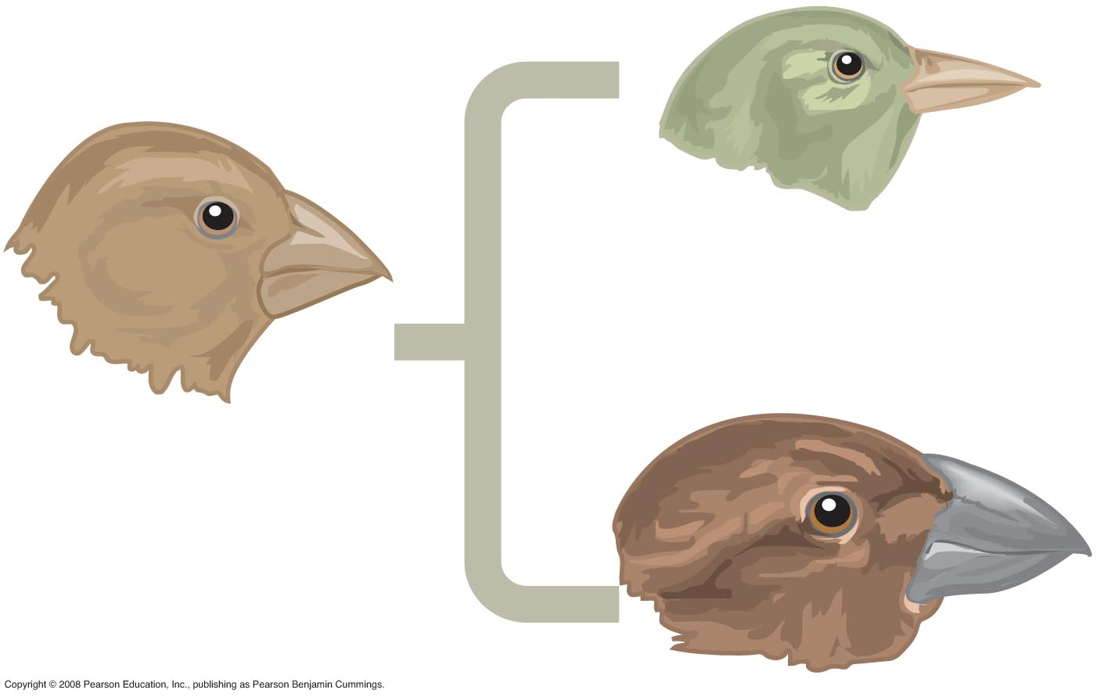
Fig. 1-UN1

Slide 77
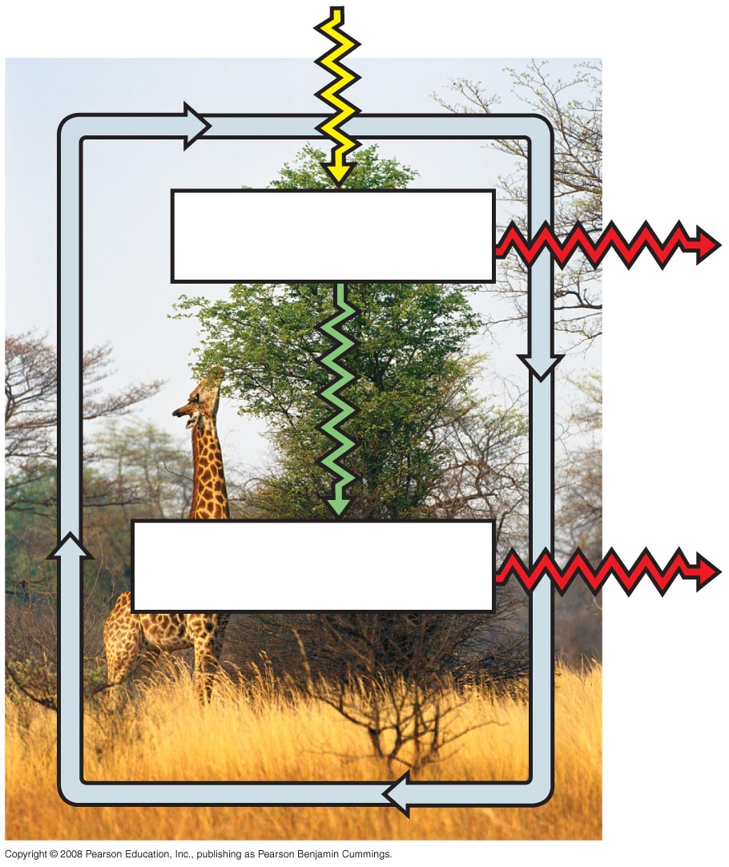
Fig. 1-UN3
Producers
Consumers

Slide 78
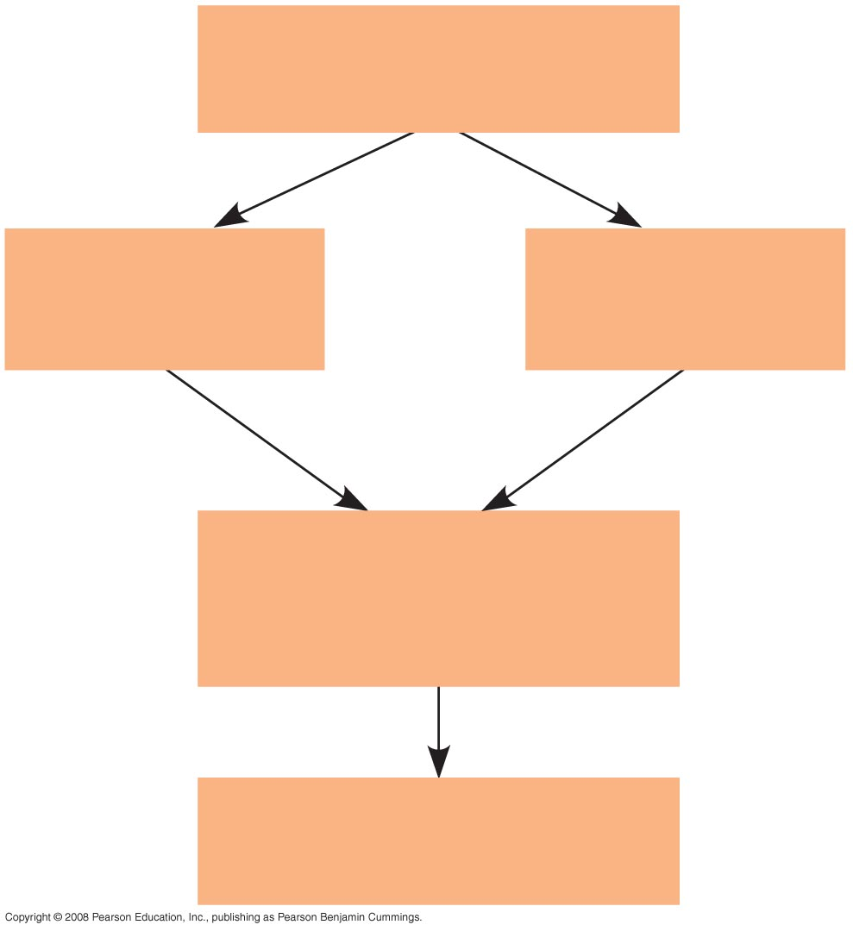
Fig. 1-UN8
Population
of organisms
Hereditary
variations
Overproduction
and competition
Environmental
factors
Differences in
reproductive success
of individuals
Evolution of adaptations
in the population

Slide 79
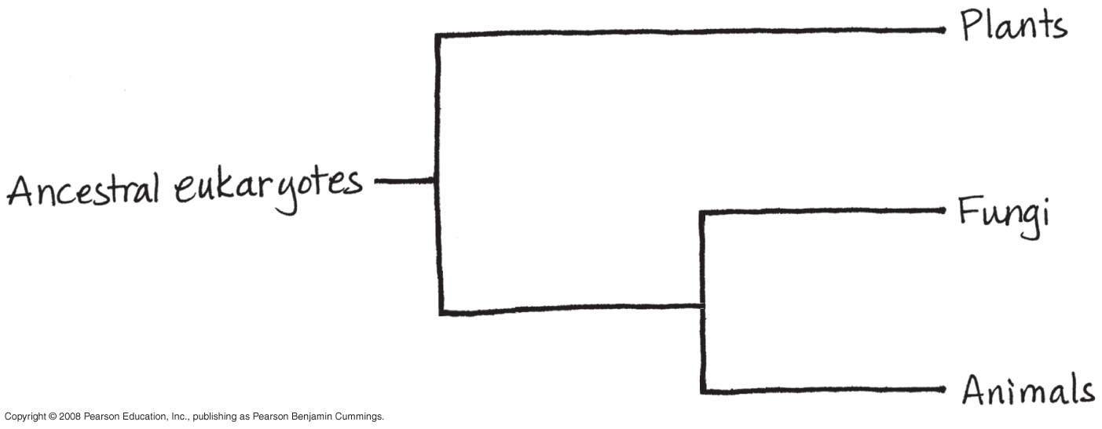
Fig. 1-UN9

Slide 80
You should now be able to:
Briefly describe the unifying themes that characterize the biological sciences
Distinguish among the three domains of life, and the eukaryotic kingdoms
Distinguish between the following pairs of terms: discovery science and hypothesis-based science, quantitative and qualitative data, inductive and deductive reasoning, science and technology
Copyright © 2008 Pearson Education, Inc., publishing as Pearson Benjamin Cummings

